Slide 1
Texture Synthesis using wang tile and graph cut
Progress review
9757553 顏志晟

Slide 2
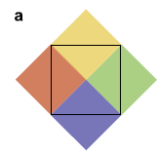
Problem1

Slide 3
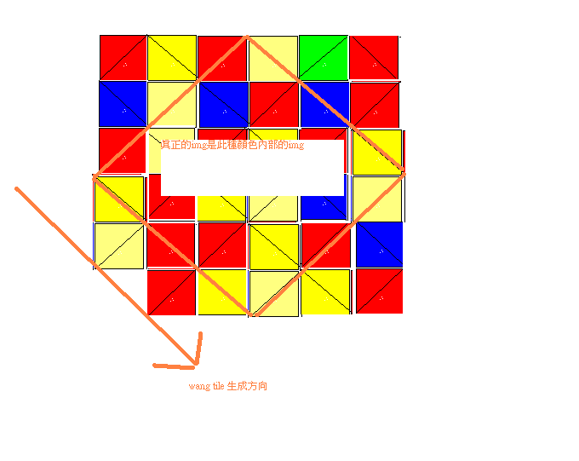
Solution1

Slide 4

Problem2—Graph cut

Slide 5
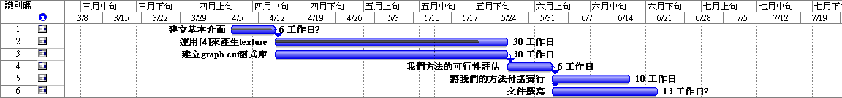
Schedule

Slide 6
Some Demo

